Slide 1
Safety in science
Sabina Cleary
Kaha Education ⎪ NZASE
Presentation to participants at
ConSTANZ, Wellington, 10 October 2019

Slide 2
Outline
Safety in science document update
Culture of safety
Legislation & roles
Laboratory manager
Some key points
inventory; risk assessment; SMU; PPE; signage & access; labelling; food & drink
Other questions

Slide 3
Safety in science
Notes:
The intent of the document is to provide the most important information needed to ensure safety in relation to science in schools. For information about specific aspects which are not covered in this document, contact the Ministry of Education (MOE), WorkSafe New Zealand, or the New Zealand Association of Science Educators (NZASE).

Slide 4
Some “new” sections
Pregnant and expecting mothers
Inclusion
Lone working
Notes:
Being edited, proofed, formatted

Slide 5
Notes:
Next … MOE legal team
Then will be available
… will keep you updated …

Slide 6
In the meantime …
Use the Guidance to the Code of Practice
Contact NZASE, WorkSafe, MOE for anything not in the current guidance document

Slide 7
Developing a culture of safety
A safety culture is an organisational culture that places a high level of importance on safety beliefs, values and attitudes—and these are shared by the majority of people within the company or workplace.
It can be characterised as ‘the way we do things around here’.
A positive safety culture can result in improved workplace health and safety (WHS) and organisational performance.
https://www.worksafe.qld.gov.au/__data/assets/pdf_file/0004/82705/understanding-safety-culture.pdf
Notes:
Language used is important – discussions should centre on safety of staff, students and visitors

Slide 8
legislation
Health and Safety at Work Act 2015 (HSWA)
Health and Safety at Work (Hazardous Substances) Regulations 2017
Health and Safety at Work (Worker Engagement, Participation and Representation Regulations) 2016
Hazardous Substances and New Organisms (HSNO)Act 1996
Standards New Zealand
The Animal Welfare Act 1999
The Building Act 2004
The Education (Update) Amendment Act 2017
The Electricity Act 1992
Fire Safety and Evacuation of Buildings Regulations 2006
The Gas Act 1992
The Health Act 1956
The Radiation Protection Act 1965
The Resource Management Act 1991
The Wildlife Act 1953.
Notes:
HSWA requires that all PCBUs must involve their workers and health and safety representatives in workplace health and safety matters by:
engaging with workers on health and safety matters that may directly affect them, so far as is reasonably practicable
having worker participation practices that give workers reasonable opportunities to participate effectively in improving health and safety on an ongoing basis.
The Regulations prescribe requirements for managing the risks associated with hazardous substances in the workplace.
The Health and Safety at Work (General Risk and Workplace Management) Regulations 2016 (“GRWM Regulations”) apply to all workplaces and include provisions on risk management processes, workplace facilities, emergency plans and personal protective equipment (PPE) and also prescribe health monitoring
requirements.
The HSNO Act places requirements on:
manufacturers, importers and suppliers of hazardous substances to ensure that:
the hazardous substances they manufacture, import or supply are approved under the HSNO Act
the hazardous substances are classified, packaged and labelled, and that they obtain or prepare a safety data sheet in accordance with the relevant EPA Notices.
the disposal of hazardous substances
using and storing hazardous substances in non-workplaces
using and storing ecotoxic substances in both workplaces and non-workplaces.
Standards New Zealand is a business unit within the Ministry of Business, Innovation and Employment. They are New Zealand's leading developer of standards and standards based solutions.
The majority of the standards are developed in partnership with Standards Australia.

Slide 9
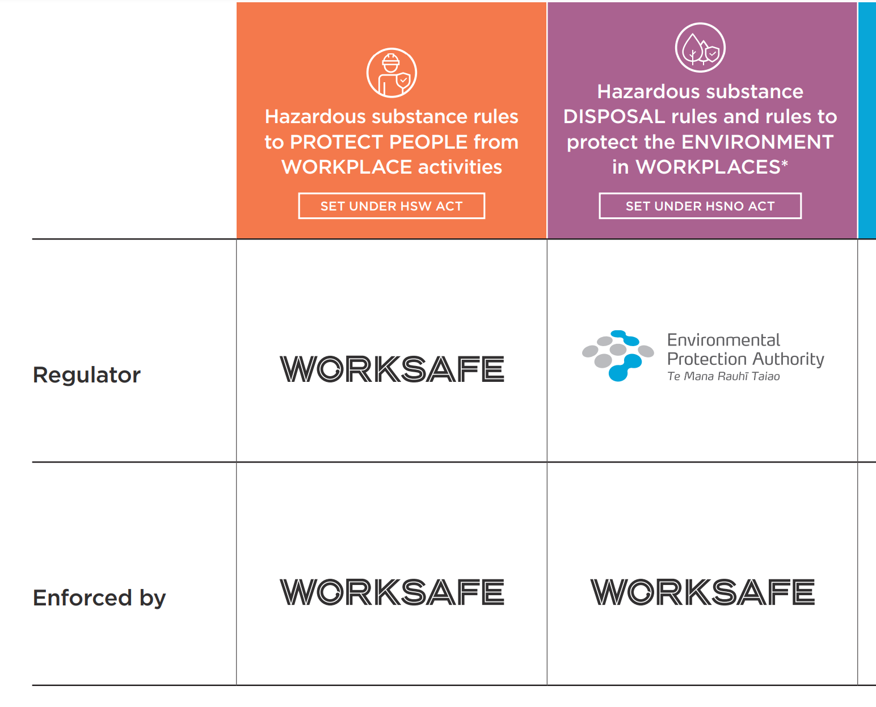
There are other hazardous substance environmental and disposal rules set under the Resource Management Act and local council bylaws. These rules are enforced by local, district and regional councils.
Notes:
WorkSafe is responsible for:
the rules that protect people from work-related activities involving hazardous substances
enforcing the rules for the ‘downstream’ manufacture, use, handling and storage of hazardous substances in the workplace
enforcing the HSNO Act ecotoxic and disposal requirements in the workplace.
The EPA regulates hazardous substances under the HSNO Act.
The EPA is responsible for:
approving and classifying hazardous substances for use in New Zealand
setting and enforcing the “upstream” rules for importers, manufacturers and suppliers of hazardous substances
setting the rules to protect the environment, and people in non-workplaces, from hazardous substances.

Slide 10
Notes:
If you are also on the Health and Safety Committee you have additional responsibilities

Slide 11
Notes:
Technicians support the laboratory manager and teachers in manging the practical requirements of science programmes. They typically prepare experiments and demonstrations, make up solutions, order equipment and chemicals, tidy up laboratories and support teachers in day to day teaching in school laboratories.
Technicians may also be appointed to the position of laboratory manager, or may work closely with the laboratory manager to support them in their duties.

Slide 12
Laboratory manager

Slide 13
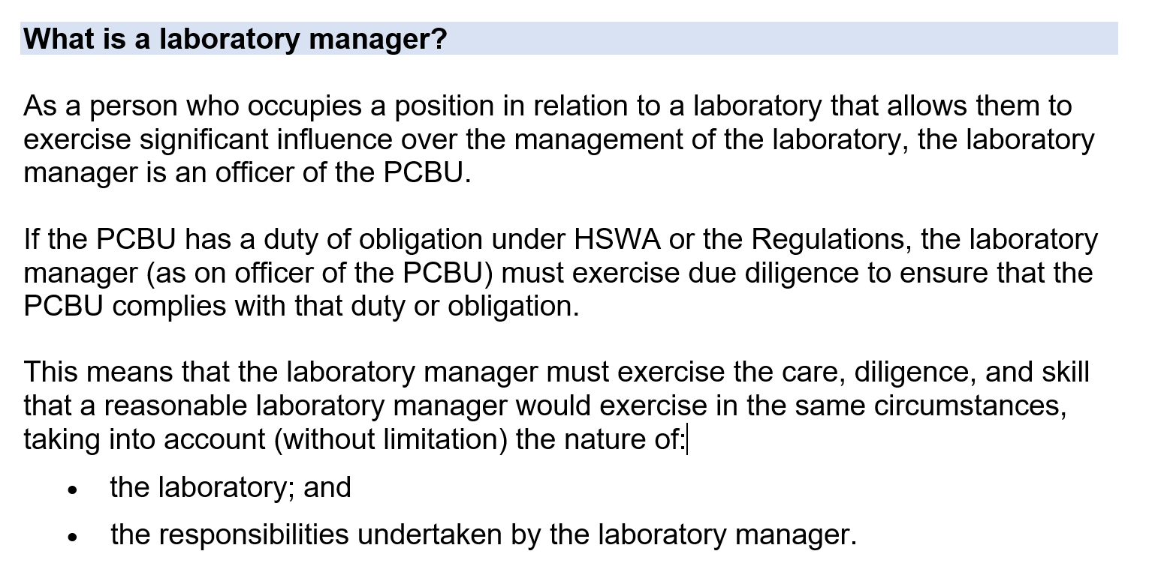
Notes:
Document has further details about the responsibilities of a laboratory manager; and also the expected required knowledge and experience.

Slide 14
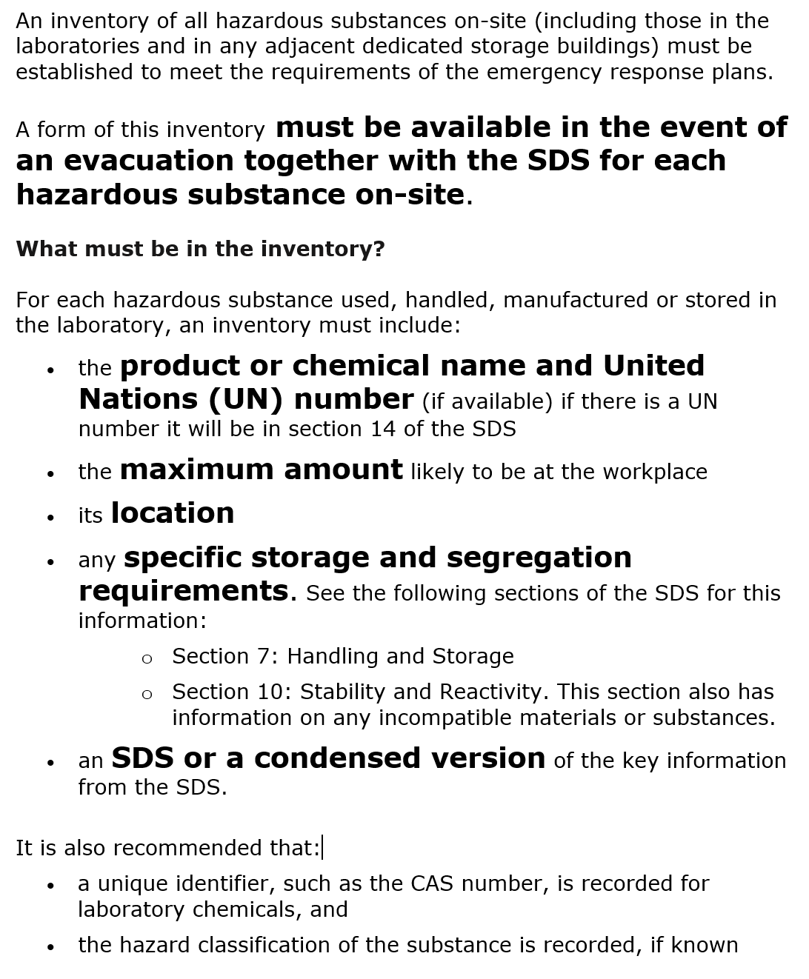
Inventory

Slide 15
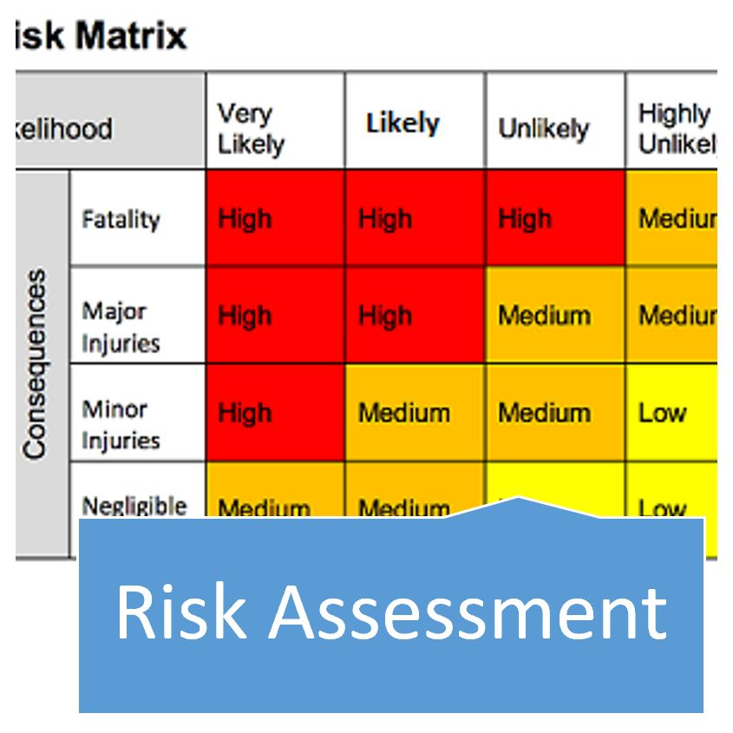
provide important information about hazardous substances
mandatory to have a current SDS for each of the hazardous substances in your school
must be provided by supplier
copies with inventory
used to carry out risk assessment
used to write the SMU
written sets of instructions that document how to safely perform work involving hazardous materials or hazardous operations.
is a process (not a form)
is about taking the practical steps to protect people from harm

Slide 16
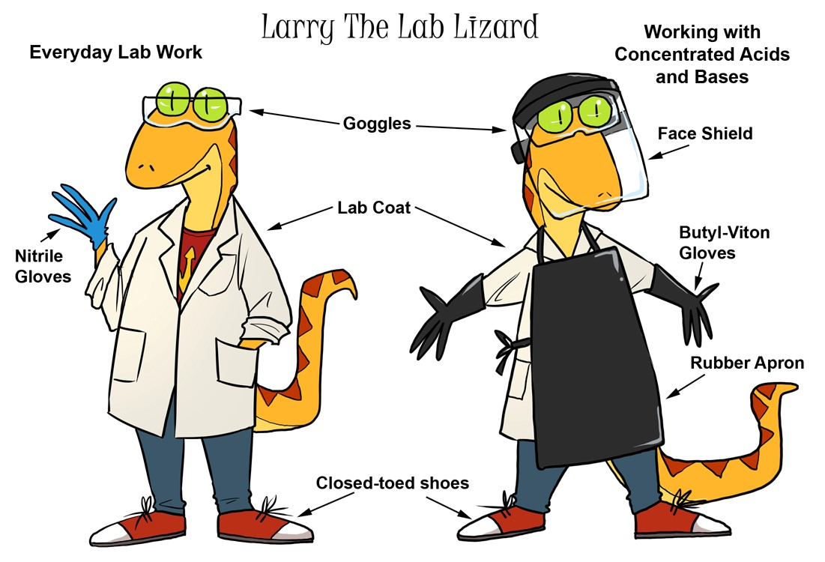
PPE
Safety goggles
Gloves
Lab coats
Appropriate footwear
Appropriate clothing
Notes:
Safety goggles – inside entrance door to lab and prep room
Appropriate gloves – cotton liners for allergies
Footwear – including teachers coming into the prep room

Slide 17
Signage
All entrances to the laboratory (which may be a building) must be clearly marked with the following (or similar) sign:
Signs warn other people at the workplace and emergency services that hazardous substances are present.
Emergency services use signs to plan their response and select appropriate PPE.
Notes:
A laboratory is a vehicle, room, building, or any other structure set aside and equipped for scientific experiments or research, for teaching science, or for the development of chemical or medicinal products.

Slide 18
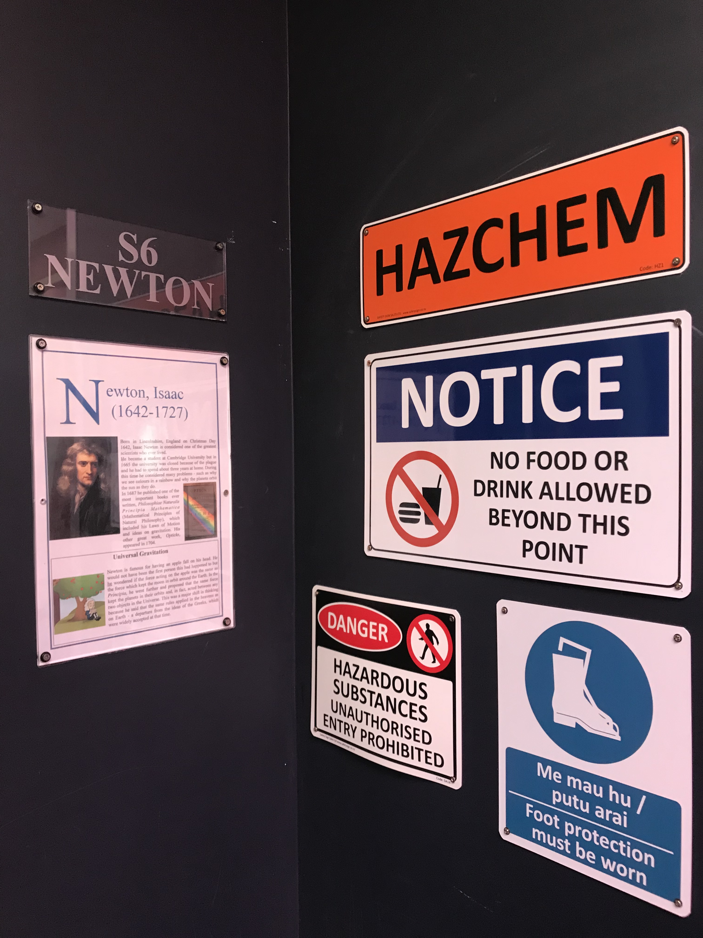
Access
Who has keys:
to prep room?
to storage areas?
Cleaners?
Notes:
The following conditions apply to all laboratories:
Entry must be restricted to authorised persons and clearly marked by signage.
The laboratory must be locked when not under the supervision of the laboratory manager or the person nominated to be in charge (delegate) by the laboratory manager.
Key holders - ? Relievers, “other” teachers, property manager, caretaker
Prep room and hazardous substances storage access – who has Keys? Cleaners?

Slide 19
labelling
Secondary containers
Containers for immediate use
Chemical waste containers
Notes:
Labels on secondary containers and prepared solutions
Secondary containers of hazardous substances need to be labelled with:
the identity of the substance
the concentration of the substance
an icon indicating the hazardous properties of the substance
an indication of the precautions required when handling the substance if possible.
Containers for immediate use
These chemicals are to be used within a laboratory session.
Label all containers in immediate use with the following:
chemical name (as it appears on the SDS)
concentration of the substance
necessary handling and hazard information
Vials and test tubes may have hazard labels affixed to the rack or container in which they are held, rather than on each vial or test tube, so long as every vial or test tube in the rack or container presents the same hazard.
If the small containers (including reaction vessels) will be left unattended, the contents should be readily identifiable using direct labelling, sample coding, rack identification, or other means.
As soon as no longer actively required, the hazardous substances must be either disposed of or labelled and the containers considered as storage containers.
Chemical waste containers
All containers for chemical waste should be labelled with:
“WASTE” or “HAZARDOUS WASTE”
chemical name (as it appears on the SDS)
accumulation start date
hazard(s) associated with the chemical waste

Slide 20
Food & drink

Slide 22
… for your invaluable mahi
Notes:
Thanks for your invaluable mahi

